Slide 1
MD Simulation and Analysis of a TM protein-ARGOS
Tolulope Ojo

Slide 2
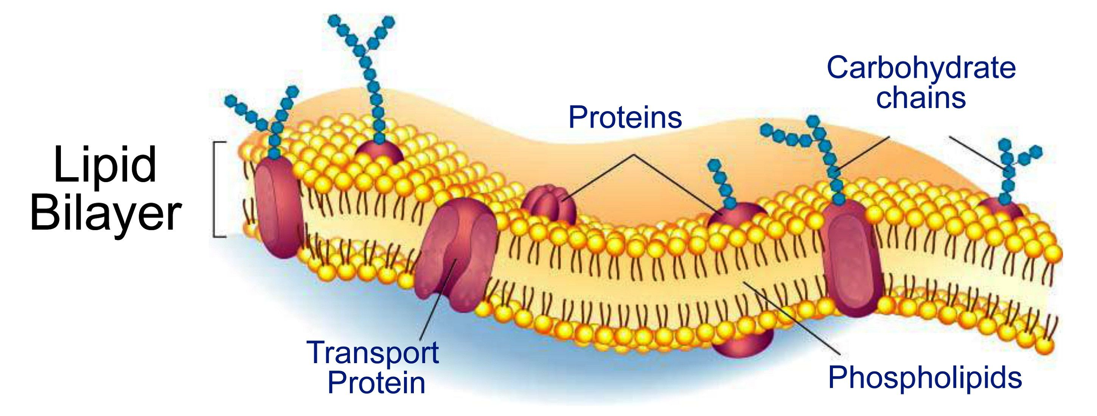
Membranes and Proteins: an overview
Membrane structure
Phospholipid bilayer
Membrane proteins
transport of ions and larger solutes
catalyzing chemical reactions
cell signaling
Interactions between proteins and lipids can shape protein conformation and the reaction coordinate of membrane-embedded enzymes.

Slide 3
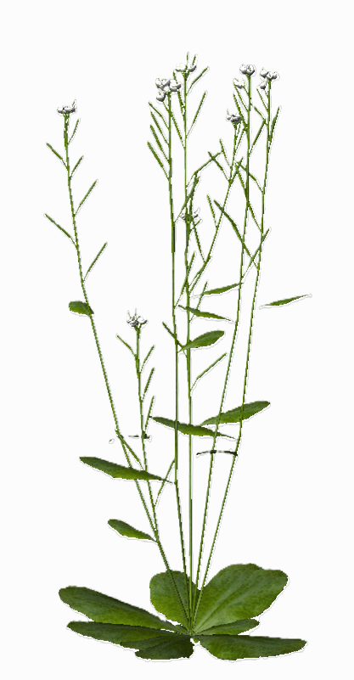
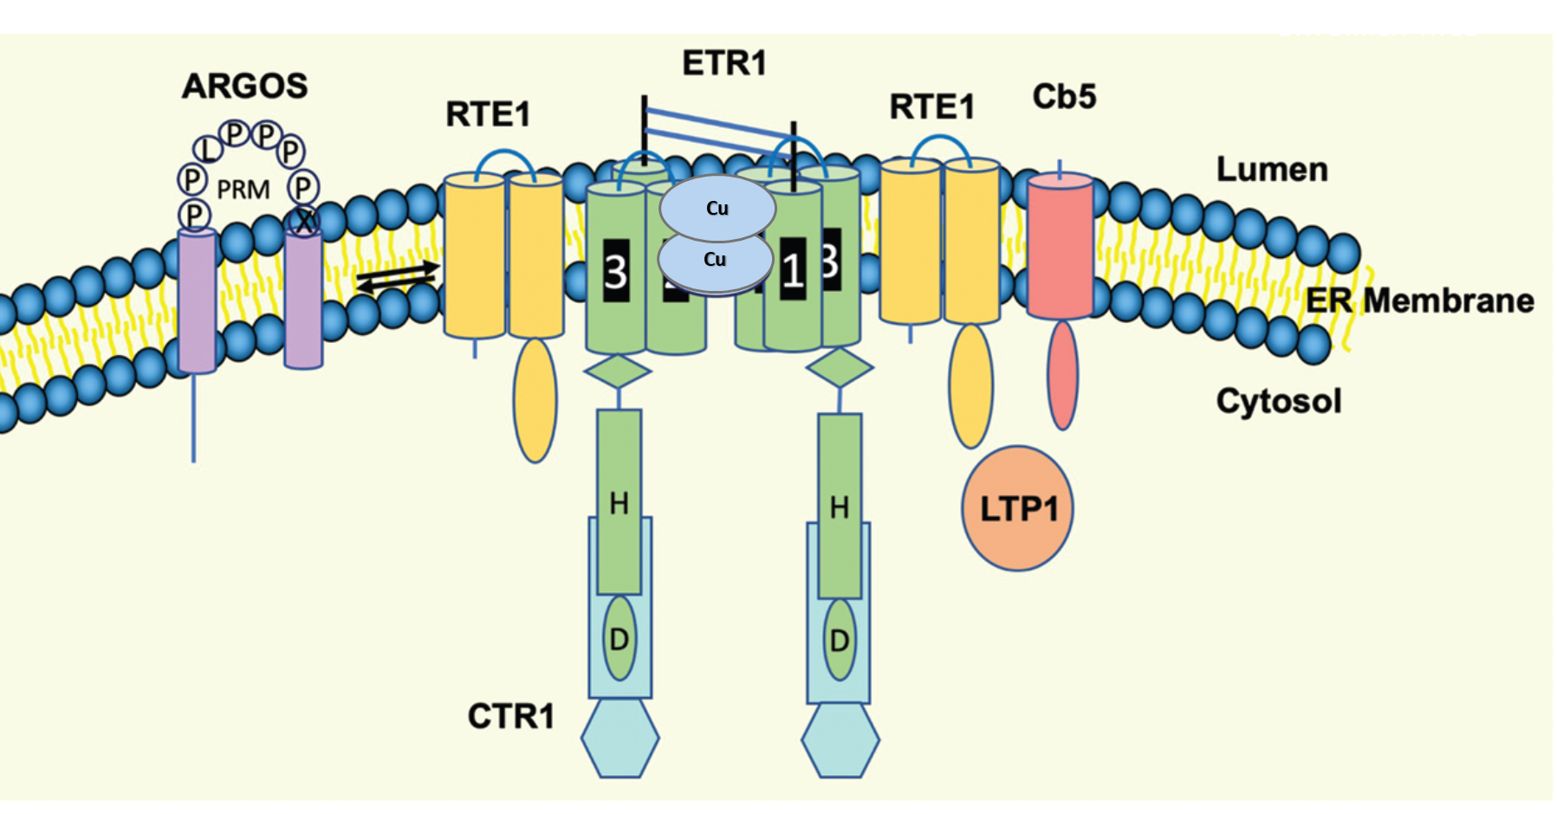
ARGOS is a regulatory transmembrane protein
ARGOS:
Localized to the ER membrane
130AA
Plays a regulatory role in ethylene signaling-fruit ripening, spoilage, plant growth
Structure unknown

Slide 4
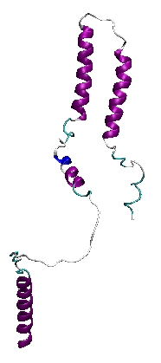
Steps for Membrane Protein Simulations of ARGOS
Predicting the structure of ARGOS with AlphaFold
Align the predicted protein along the z-axis (TmAlphaFold, OPM- Orient).
Select POPC as the lipid type and generate
Jumper et al., 2021
Dobson,L et al., 2023

Slide 5
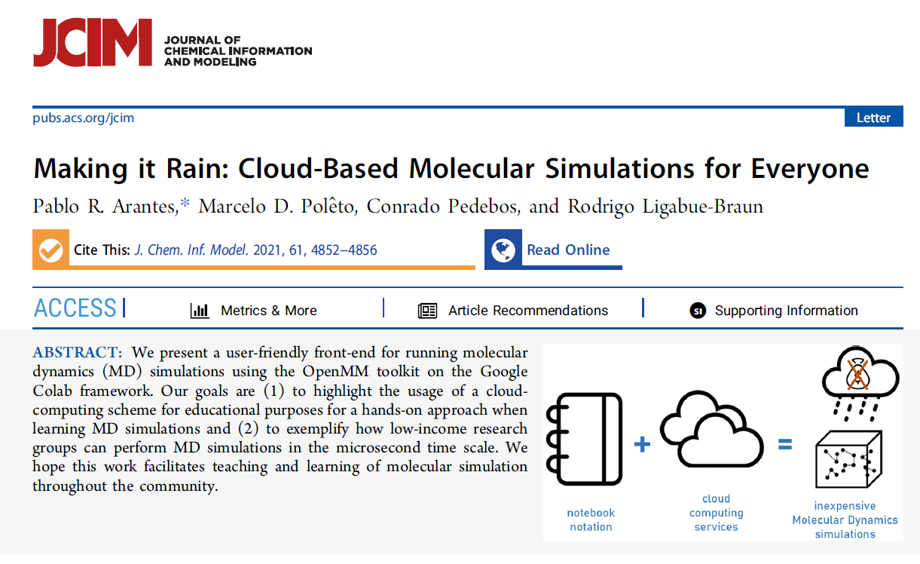
MD-simulation template

Slide 6

Steps for Membrane Protein Simulations of ARGOS
Insert protein in membrane (POPC)
Solvate outside the membrane (TIP3P)
Add counterions for electrostatic calculations
Run simulation (AMBER14SB)
Equilibrate simulation box 1ns 300k pressure 1
Production MD run 100ns
Aranthes et al., 2021

Slide 7
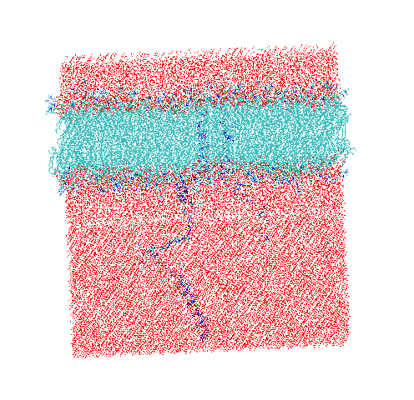
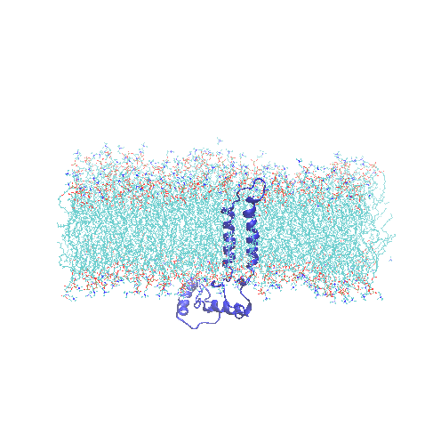
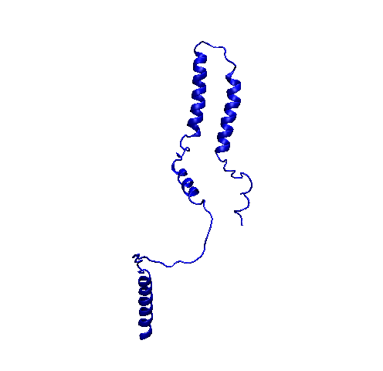
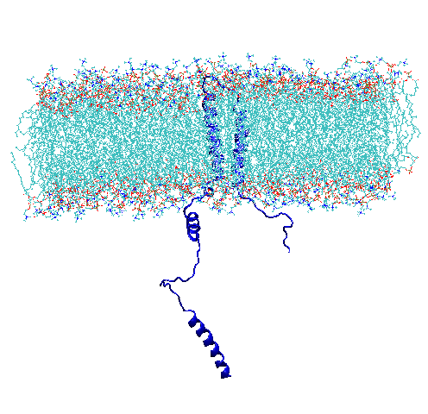
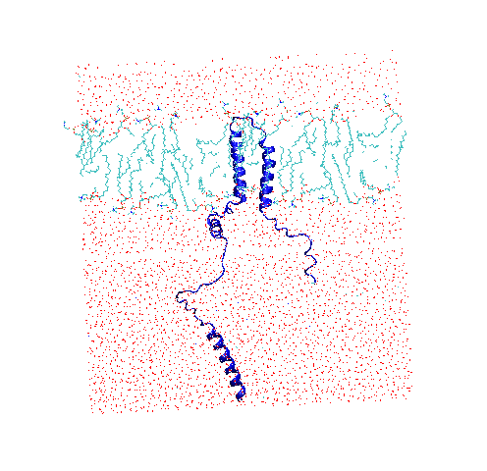
ARGOS in POPC membrane

Slide 8
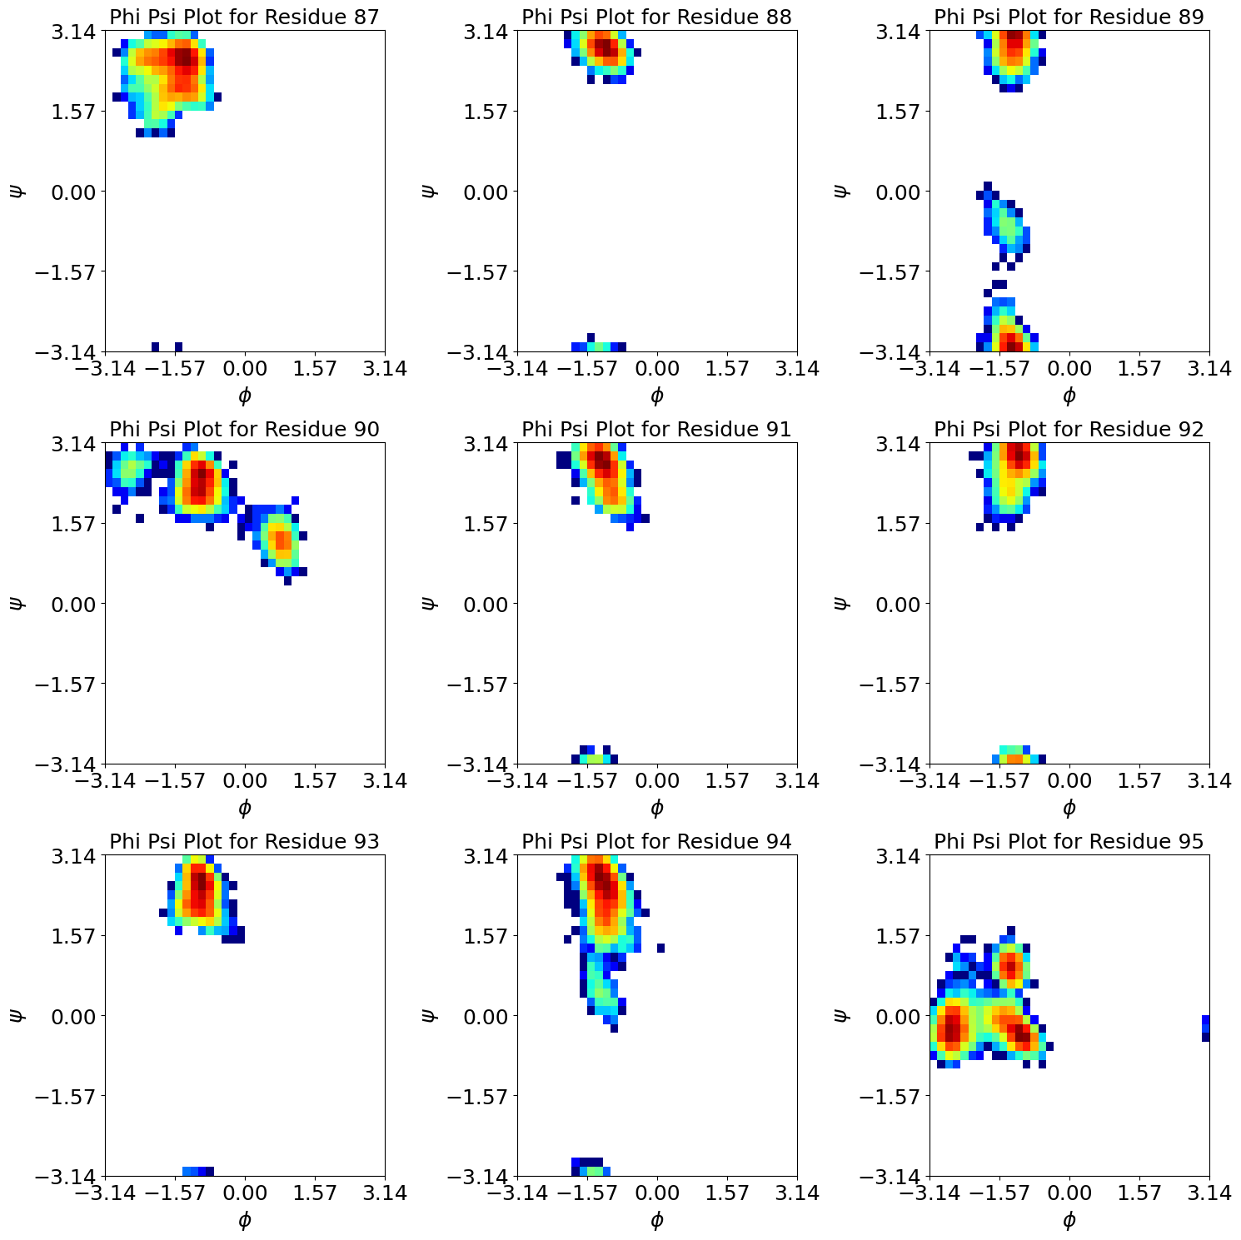
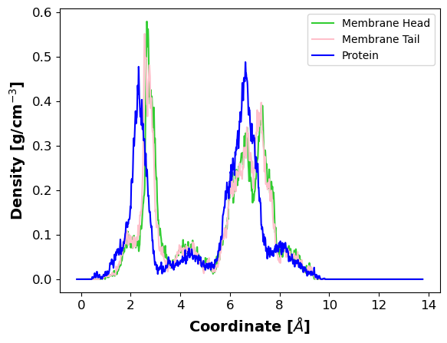
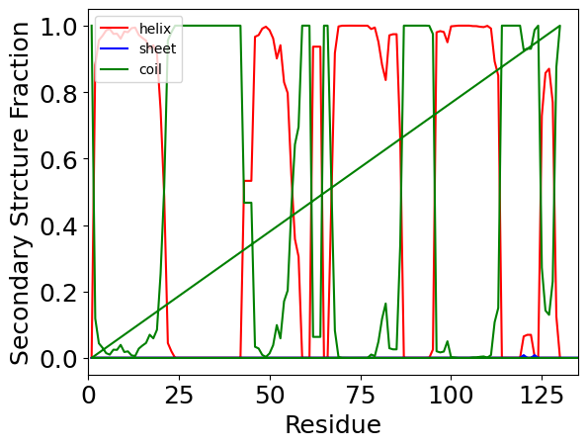
Structure analysis of ARGOS and its Proline-Rich-Motif (PRM)
Secondary structure analysis.
Compute density profiles for the subdivided parts of the system.

Slide 9
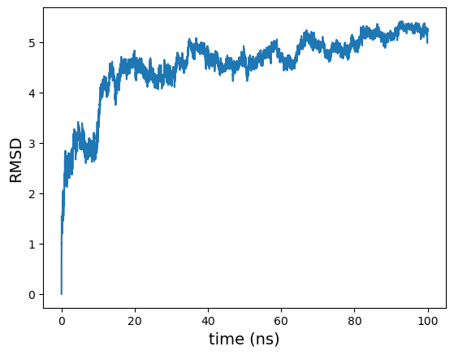
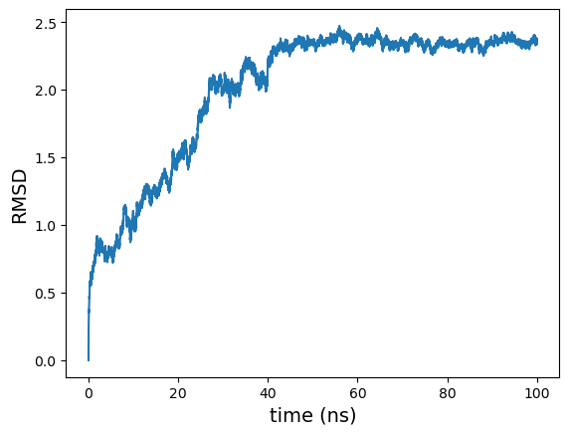
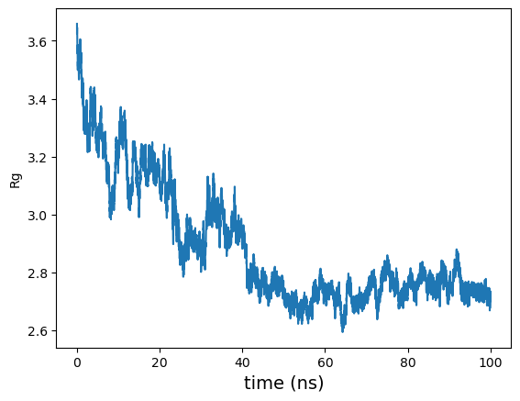
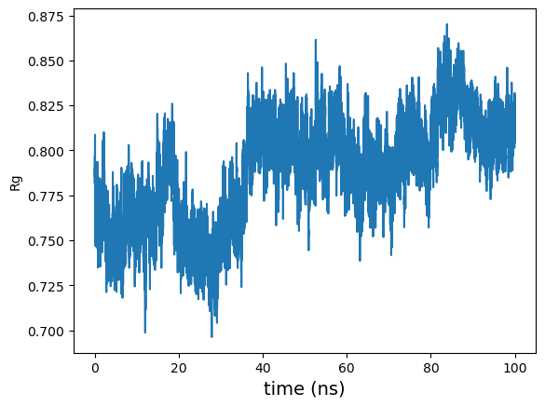
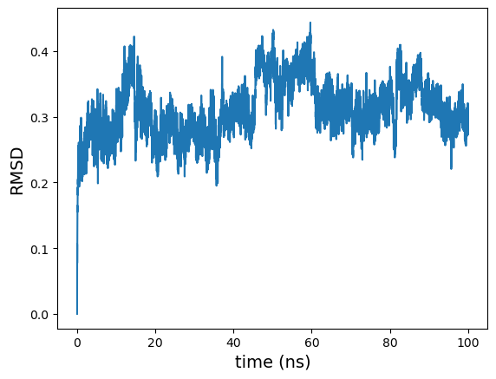
Structural Analysis
RMSD
Protein + membrane
Protein
Radius of gyration
Protein
PRM
PRM

Slide 10
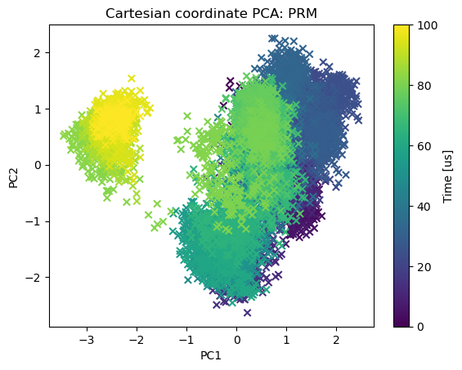
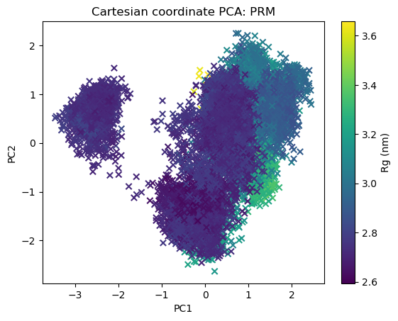
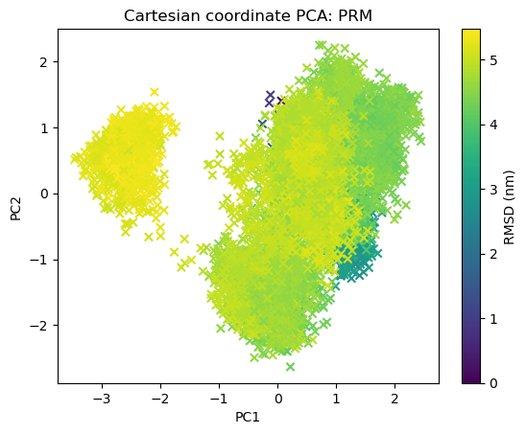
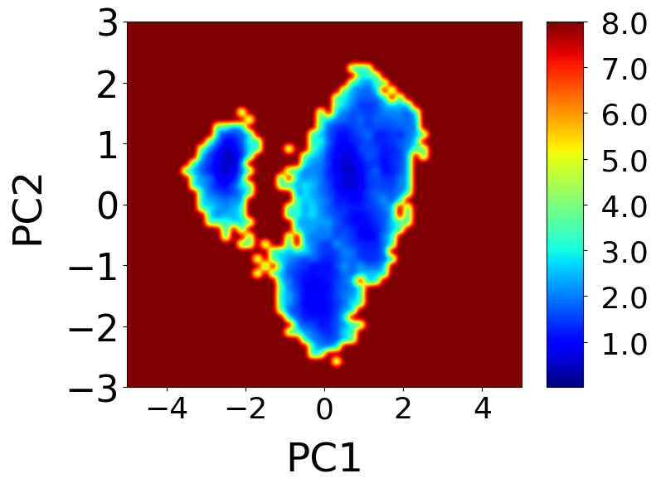
Principal component (PC)1 and and PC2 projection of the PRM
Future plans-Proline cis/trans isomerization in the PRM

Slide 11
Thank you!

Slide 12
REFERENCES
Laszlo Dobson, Levente I Szekeres, Csongor Gerdán, Tamás Langó, András Zeke, Gábor E Tusnády, TmAlphaFold database: membrane localization and evaluation of AlphaFold2 predicted alpha-helical transmembrane protein structures, Nucleic Acids Research, Volume 51, Issue D1, 6 January 2023, Pages D517–D522, https://doi.org/10.1093/nar/gkac928
Jumper, J. et al. “Highly accurate protein structure prediction with AlphaFold.” Nature, 596, pages 583–589 (2021). DOI: 10.1038/s41586-021-03819-2.
Pablo R. Arantes*, Marcelo D. Polêto, Conrado Pedebos and Rodrigo Ligabue-Braun. Making it Rain: Cloud-Based Molecular Simulations for Everyone, J. Chem. Inf. Model. 2021, 61, 10, 4852–4856. https://doi.org/10.1021/acs.jcim.1c00998

